Slide 1
DATA602 Final Project:
Who’s Valuable in Data Science?
Gullit Navarrete, 05/22/25

Slide 2
Abstract
The goal of this project and to be shown verbally through my presentation is to display the most valuable skills in the data science industry/field. I intend to do this with my research question including the methods of which will be summary statistics and visualizations upon cleaning and tidying up the data beforehand. Afterwards, I'll base my conclusions on the findings of these statistics and visual representation of value.

Slide 3
Introduction
Research Question: "What are the most valued data science skills (Programming languages and Machine Learning Tools/algorithms) in the United States of America?”
Relevance: May be used as guidance on the path to entering this job field as well as aligning employees and employers on what is typically sought after among the industry.
Dependent Variable(s): Salary and Education level are explored
Independent Variable(s): One binary for each Programming Language and Machine Learning. Additionally, Programming Language and Machine Learning tool Counts.

Slide 4
Data Import

Slide 5
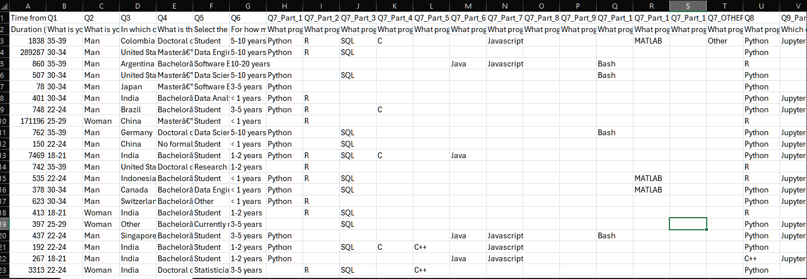
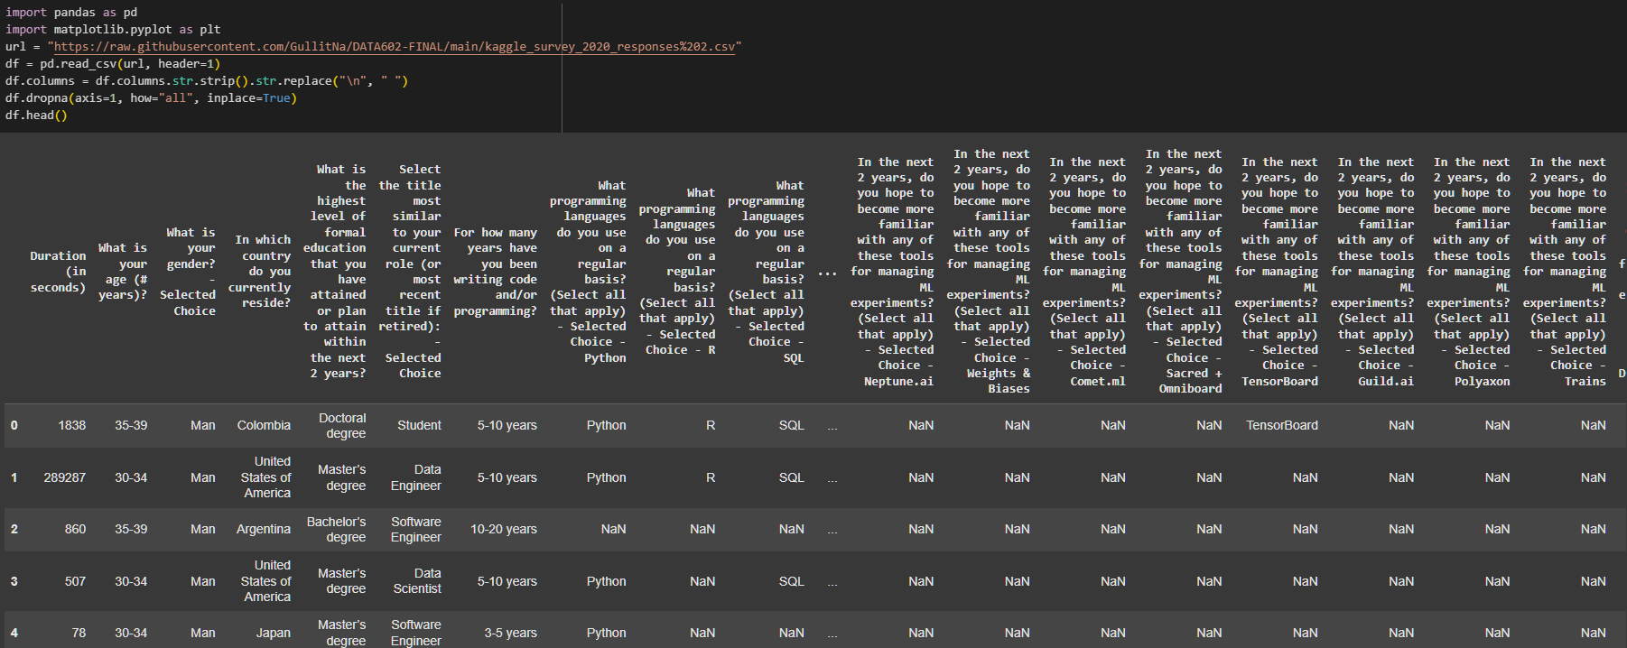
Data Import

Slide 6
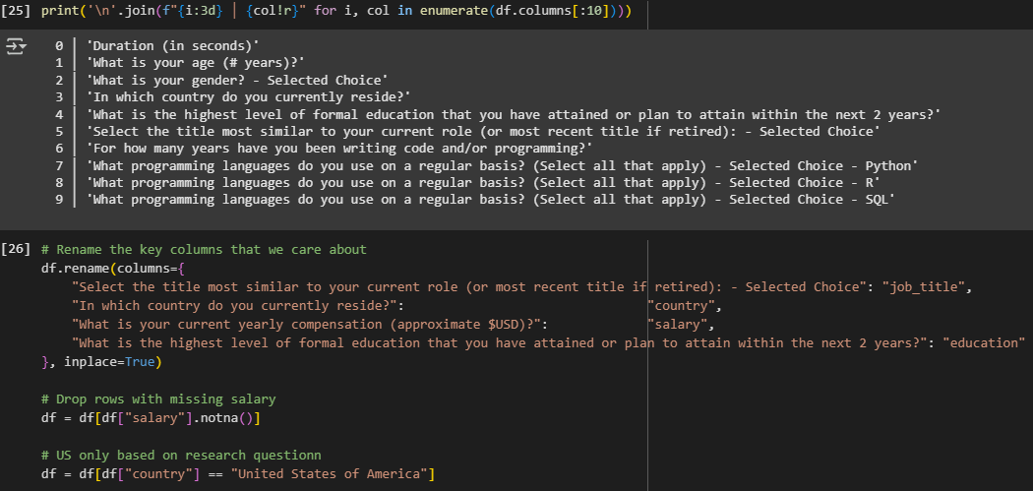
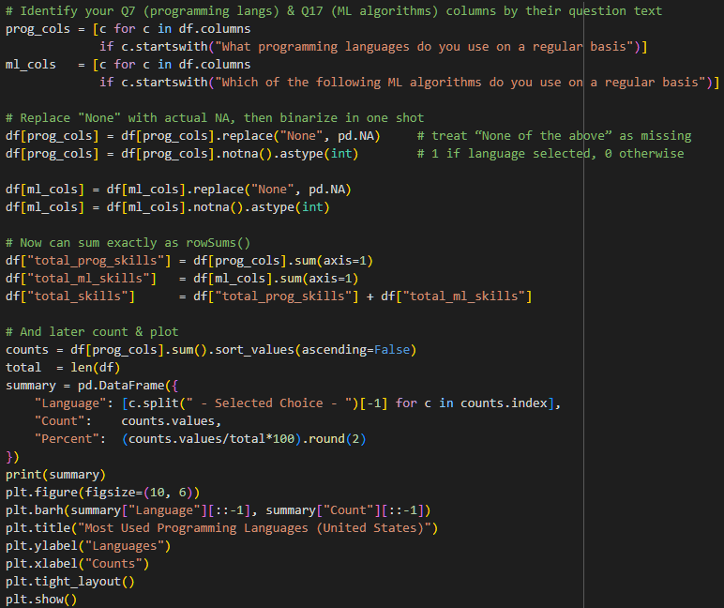
Data Wrangling
After the initial observation, I will now further clean out the data from "NA" values and most importantly, enable questions 7 and 17 to be read directly into a sum of their counts for summary statistics and eventually plotting.
The code below is how I intend to prepare the data for the analysis that will take place. By identifying the questionnaires fill out form in a "1" and "0" binary format to be read.

Slide 7
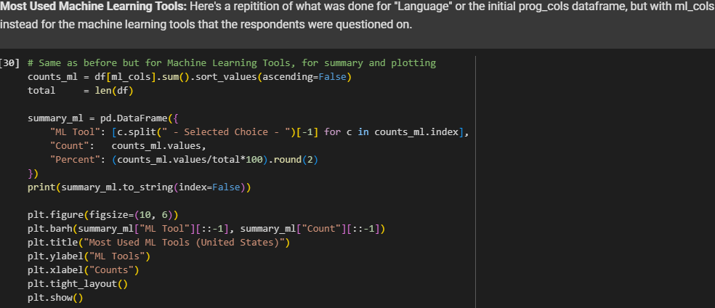
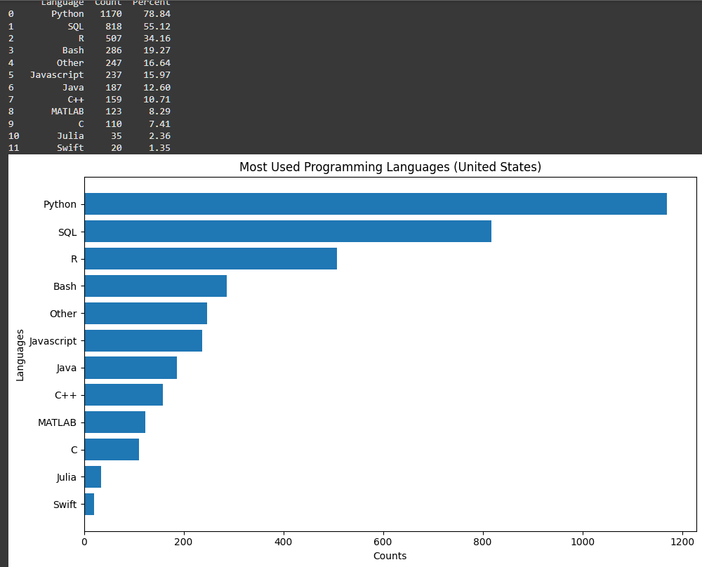
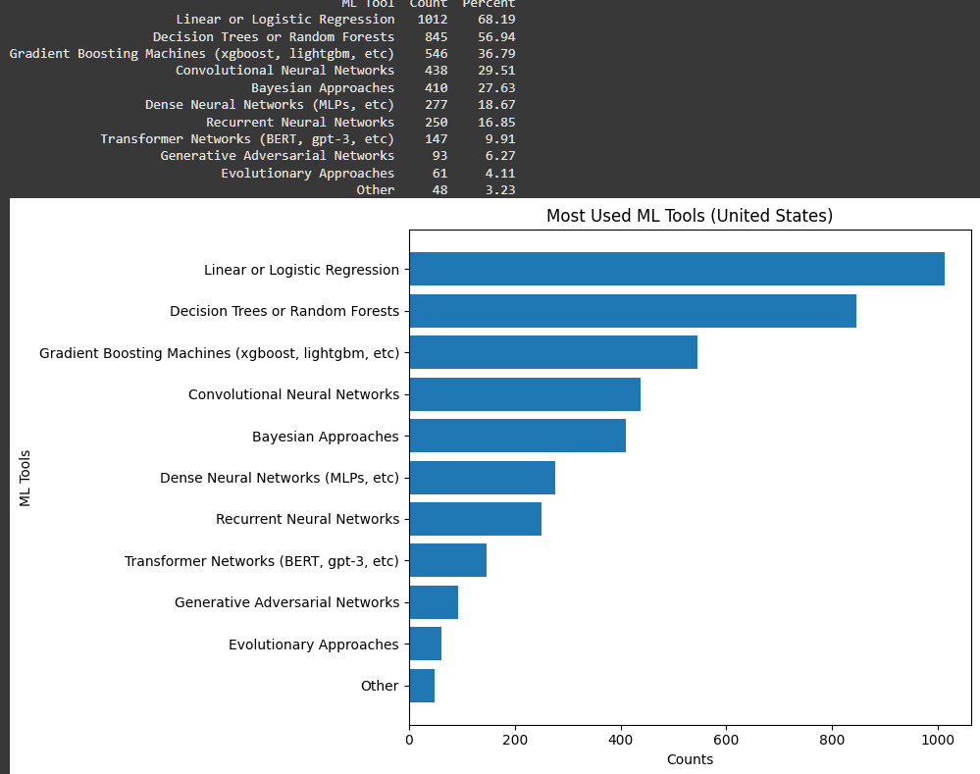
EDA and Data Analysis: Most Used

Slide 8

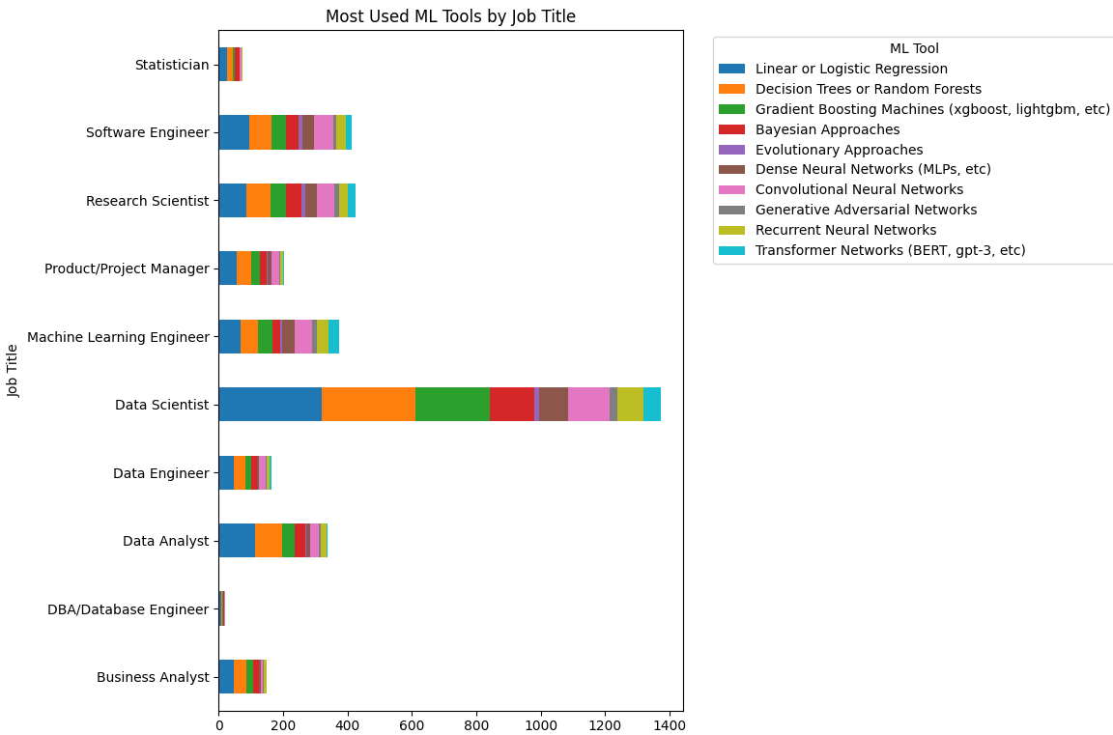
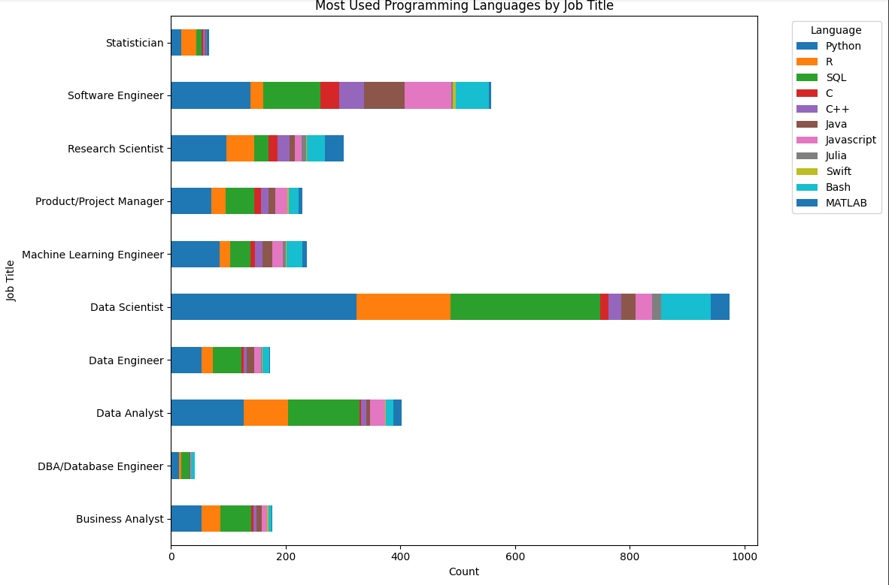
Most Used by Job Title
Other" was kept to show the overall counts within the industry. For the sake of clarity and transparency, I will remove "Other" for further analysis.
df = df[df["job_title"] != "Other"].copy()

Slide 9
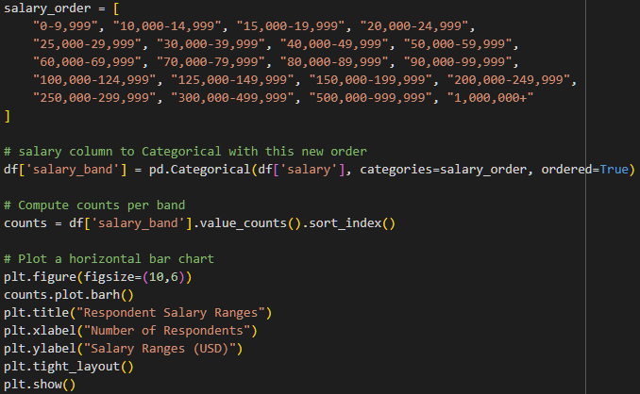
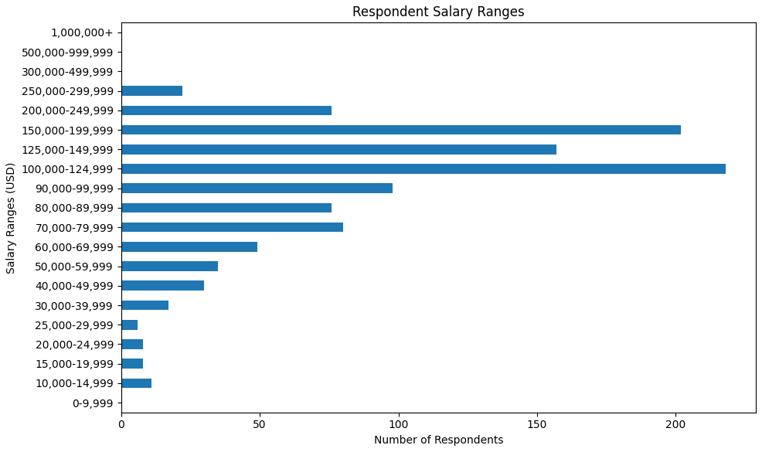
Salary
My solution to display the salary ranges of the respondents are by keeping these salary ranges from its initial string format rather than numerically and converting these ranges into singular midpoints. Why? Because having non-numeric, ordered categories. A bar chart (especially horizontal) lets you see at a glance which pay bands are most common.
As well as the research question receiving a broad answer rather than a miss/less accurate response about ranges themselves, a categorical bar chart is clearer for this case.

Slide 10
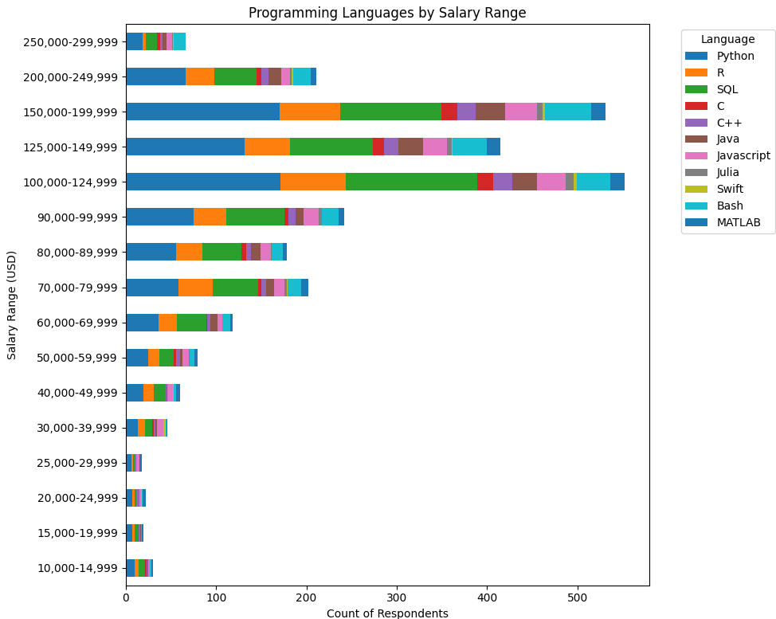
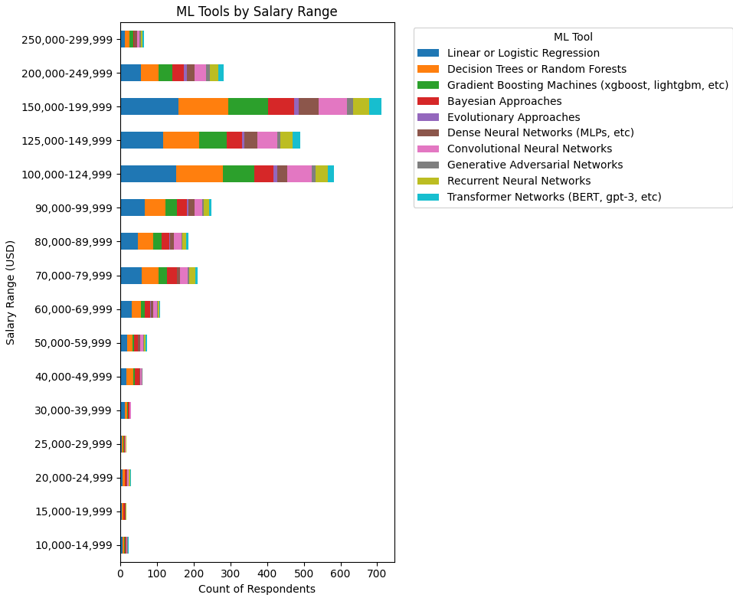
By Salary Range

Slide 11
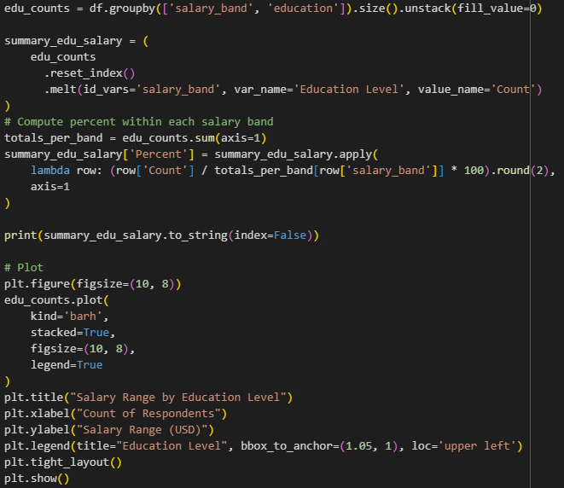
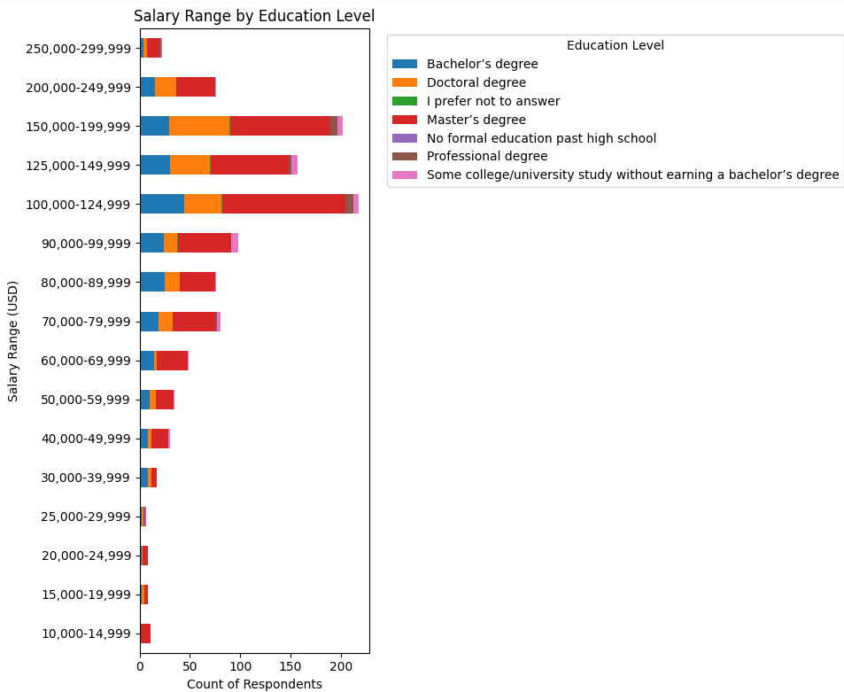
Salary Range by Education

Slide 12
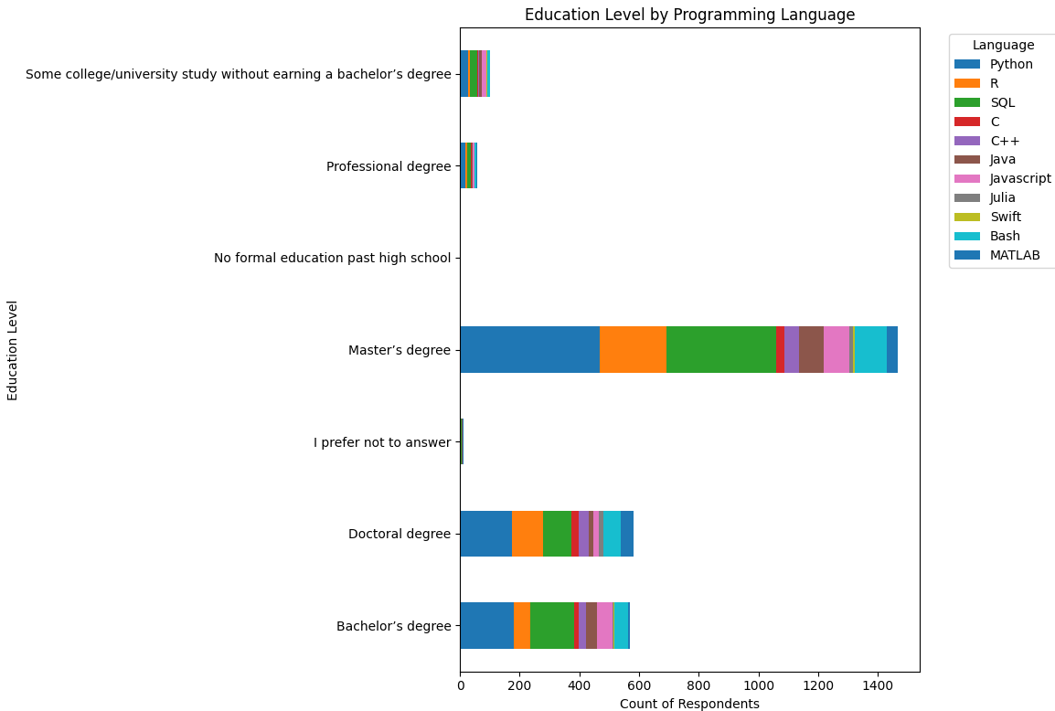
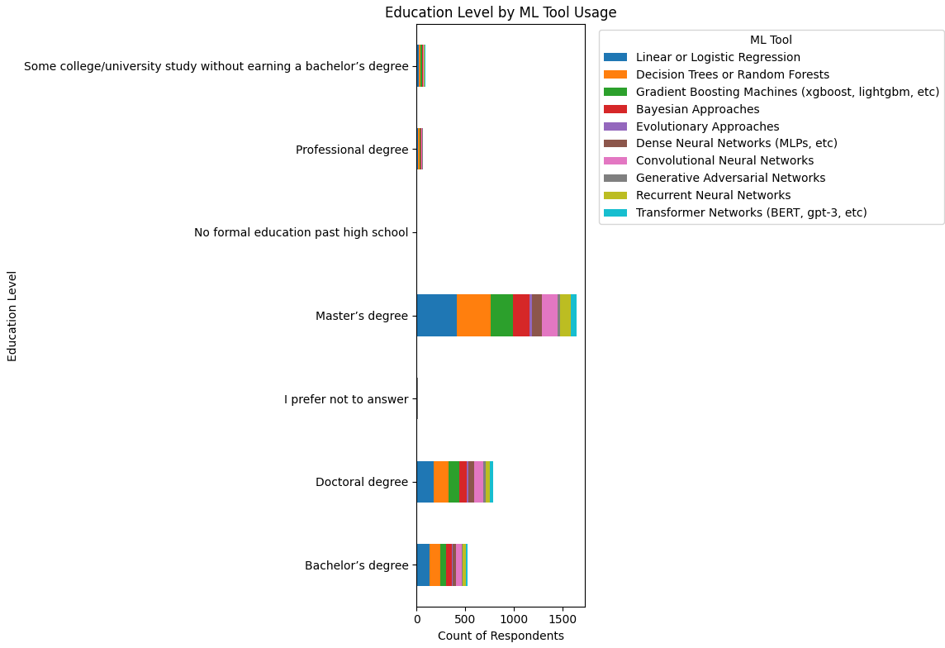
Education Level By

Slide 13
Conclusion

Slide 14
Conclusion
Based on the various visualizations throughout this project, we can infer that programming proficiency in Python and SQL are the two most consistently used skills and its popularity remains within the most used Programming Languages, right next to R, referred as also playing a strong role for many professionals. Neural networks, decision trees, gradient boosting methods, and linear/logistic regression are some of the machine learning tools and techniques that seem to be frequently utilized and appreciated. Stronger backgrounds in these programming languages and machine learning frameworks are frequently and clearly associated with better wages, and many respondents in higher salary categories have at least a bachelor's or master's degree (majority of the counts and upper salary brackets have a master's degree). The findings suggest that the most sought after set of data science competencies is a strong foundation in Python, SQL, and fundamental machine learning algorithms particularly those using linear regression, neural networks and tree-based approaches.

Slide 15
Full Overview on Sources on My Github Reposit
https://github.com/GullitNa/DATA602-FINAL

